Slide 1
Employee Data Analysis using Excel
STUDENT NAME: SUBHASREE M
REGISTER NO: 312217069 (asumn1659312217069)
DEPARTMENT: B.com (General)
COLLEGE: Shri Krishnaswamy College For Women

Slide 2
PROJECT TITLE
Employee Salary and Compensation Analysis using Excel

Slide 3


AGENDA
Problem Statement
Project Overview
End Users
Our Solution and Proposition
Dataset Description
Modelling Approach
Results and Discussion
Conclusion
3/21/2024 Annual Review

Slide 4

PROBLEM STATEMENT
It provides valuable insights that help organizations make informed decisions about their compensation strategies.
Fairness and Equity
Attracting and Retaining Talent
Legal Compliance
Performance Management
Employee Engagement and Motivation

Slide 5

PROJECT OVERVIEW
The Primary Goal of this project is to analysis employee salary data with an organization to identify trends, disparities, and potential areas for improvement in compensation practices., and ensure fair and equitable compensation strategies.
It also helps understand the Holistic Remuneration packages offered by employers. Evaluating pay equity allows organizations to compensate employees doing the same level of work in a fair way.

Slide 6



WHO ARE THE END USERS?
Human Resource (HR) Professionals
Compensation and Benefits Specialists
Finance Team
Executives and Manager
Employees and Potential Hires

Slide 7

OUR SOLUTION AND ITS VALUE PROPOSITION
Conditional Formatting
Filter
Pivot Table – Summaries
Graph – Data Visualizing

Slide 8
Dataset Description
Typically includes the following dataset to ensure a comprehensive analysis;
Employee ID: A unique identifier for each employee
Name: Employee’s full name
Department: The department where the employee works (Example: Marketing, HR, Sales, Services, Business Development and Research & Development)
Base Salary: The employees base salary before any bonuses or deductions
Performance Rating: Employee’s performance rating (if available)
Employment Type: Full time, Part time, Contract, etc…

Slide 9

THE "WOW" IN OUR SOLUTION
Fair Compensation
Market Comparison
Budgeting and Planning
Performance Evaluation
Employee Retention
Strategic Adjustments
3/21/2024 Annual Review
9

Slide 10
MODELLING
Data Cleaning:
Remove Duplicates
Handle Missing Data
Segmentation:
By job role
By Department
Pivot Table and Pivot Chart
Creating pivot table
Creating pivot chart
10

Slide 11
MODELLING
Scenario Analysis:
What If Analysis
Data Tables
Visualization:
Bar chart
Line graph
Box Plots
Reporting
Summary report

Slide 12
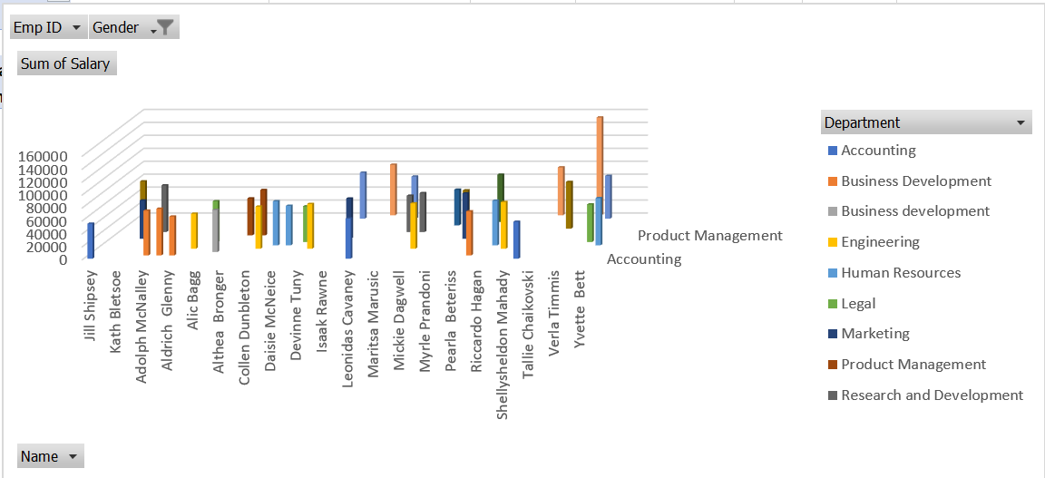
RESULTS
12

Slide 13
conclusion
In analyzing the salary data for the Project Management and Accounting department, it is evident that this department offers High salaries relative to others within the organization.
This trend suggests that the roles within Project management and Accounting department are likely considered critical to the company’s strategic growth and revenue generation, thus justifying the higher compensation.
The department may require specialized skills, experience, and performance, which are reflected in the salary structure.
This insight can help guide future compensation planning, talent, acquisition, and retention strategies to maintain competitive positioning in the market.
Thank You!

